Slide 1
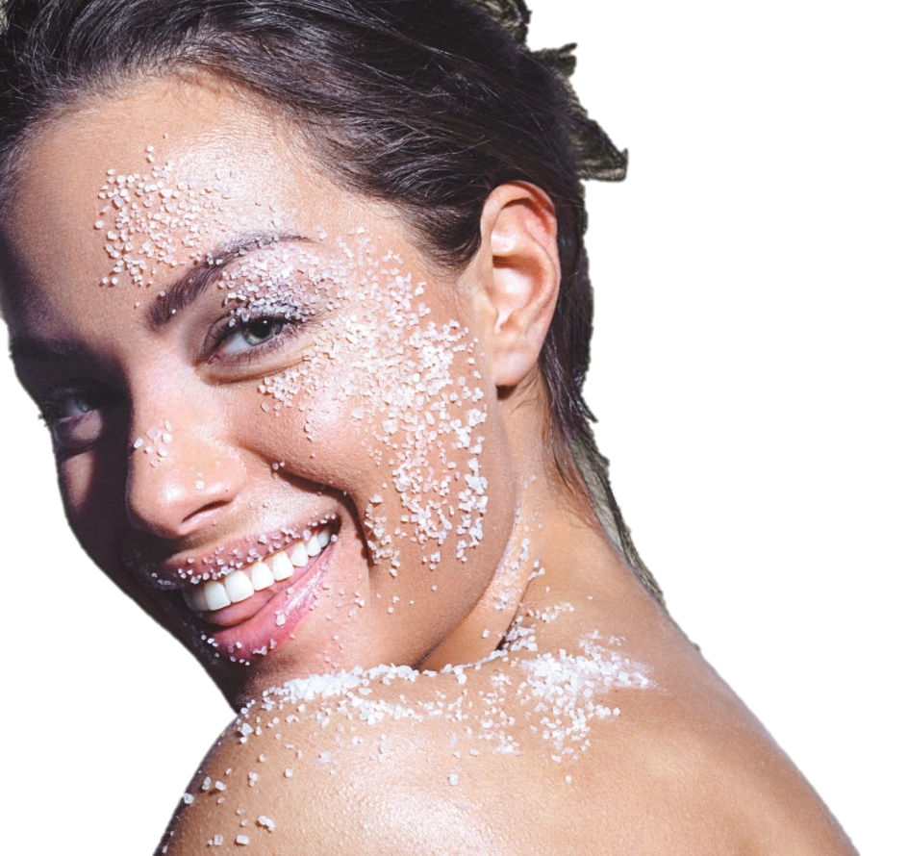



THE SCIENCE YOUR SKIN NEEDS

Slide 2
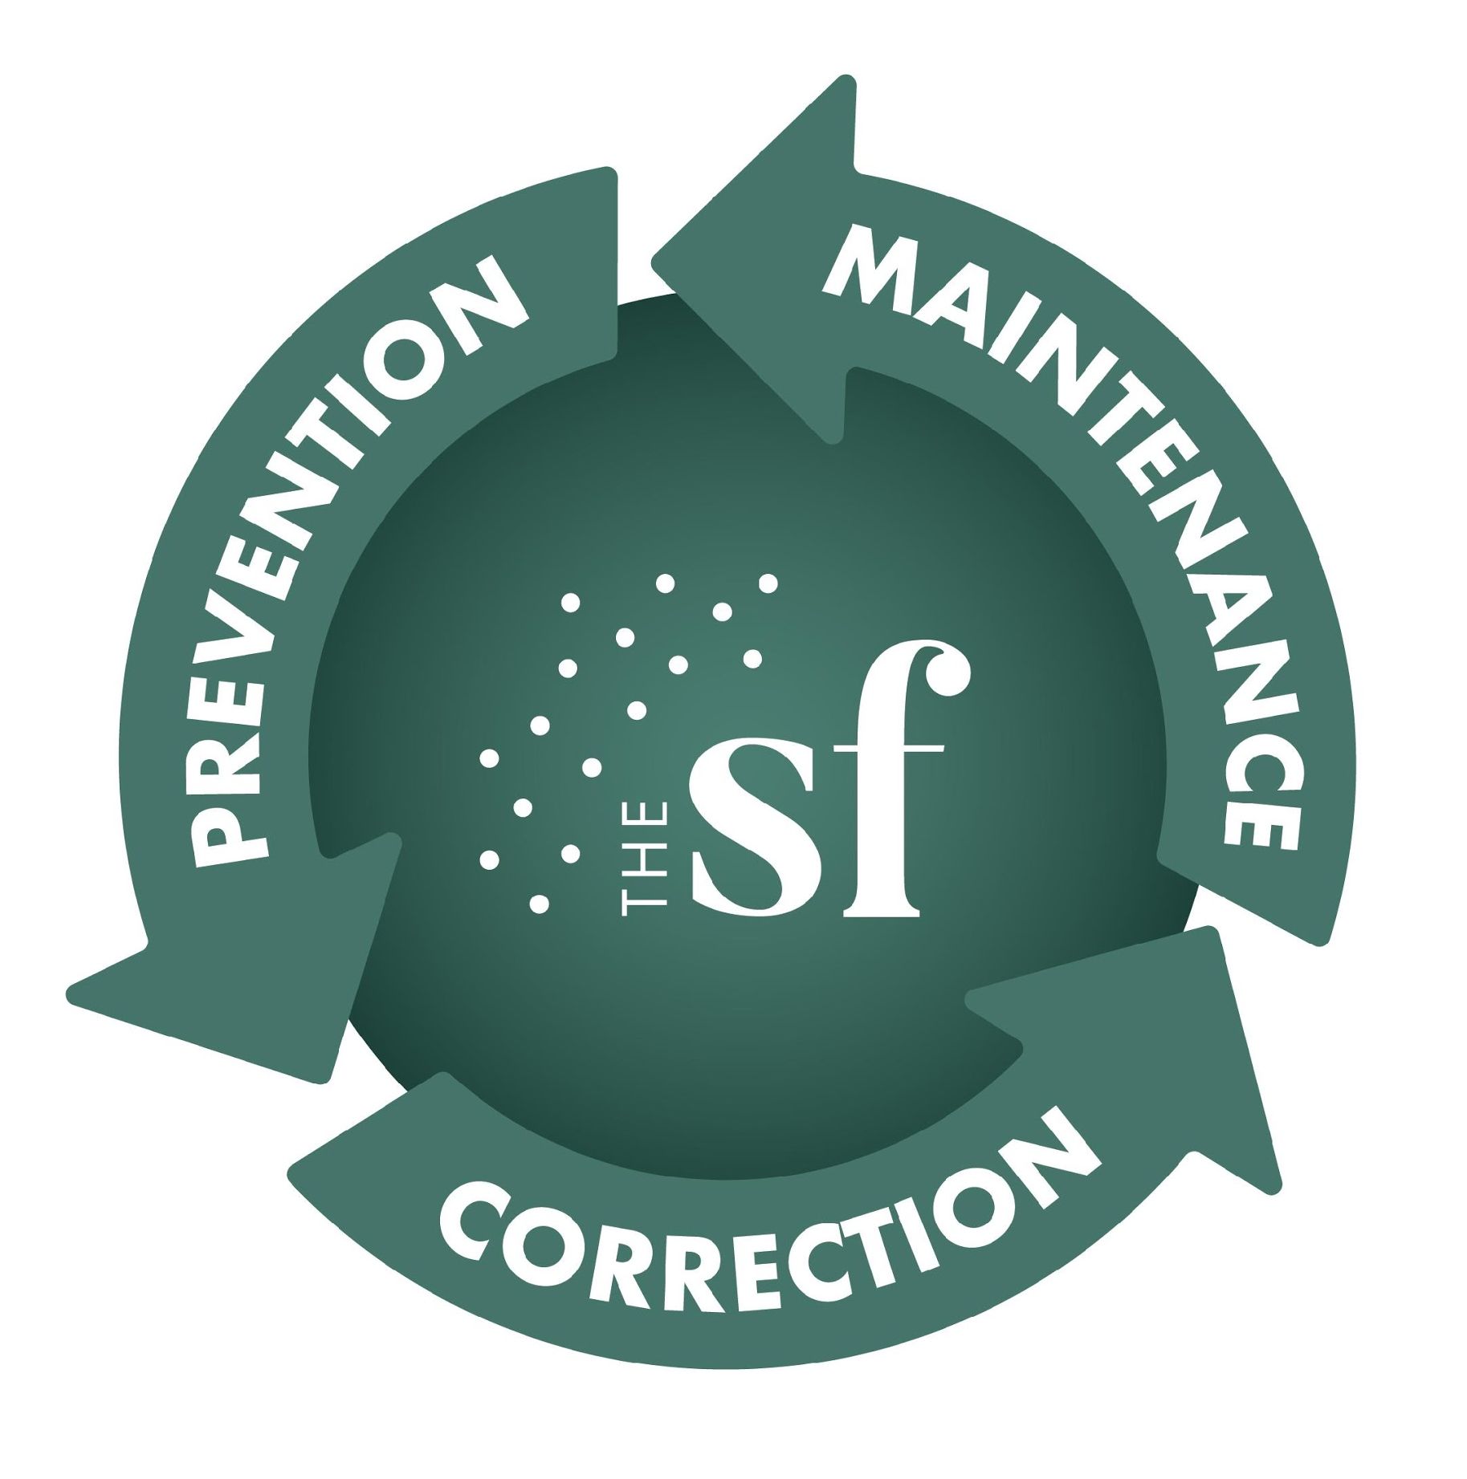
A Class II, FDA-cleared medical/ aesthetic facial device to address:
Prevention
Correction
Maintenance
of skin
…From Head to Toe!¹

Slide 3
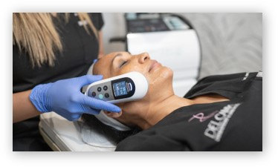
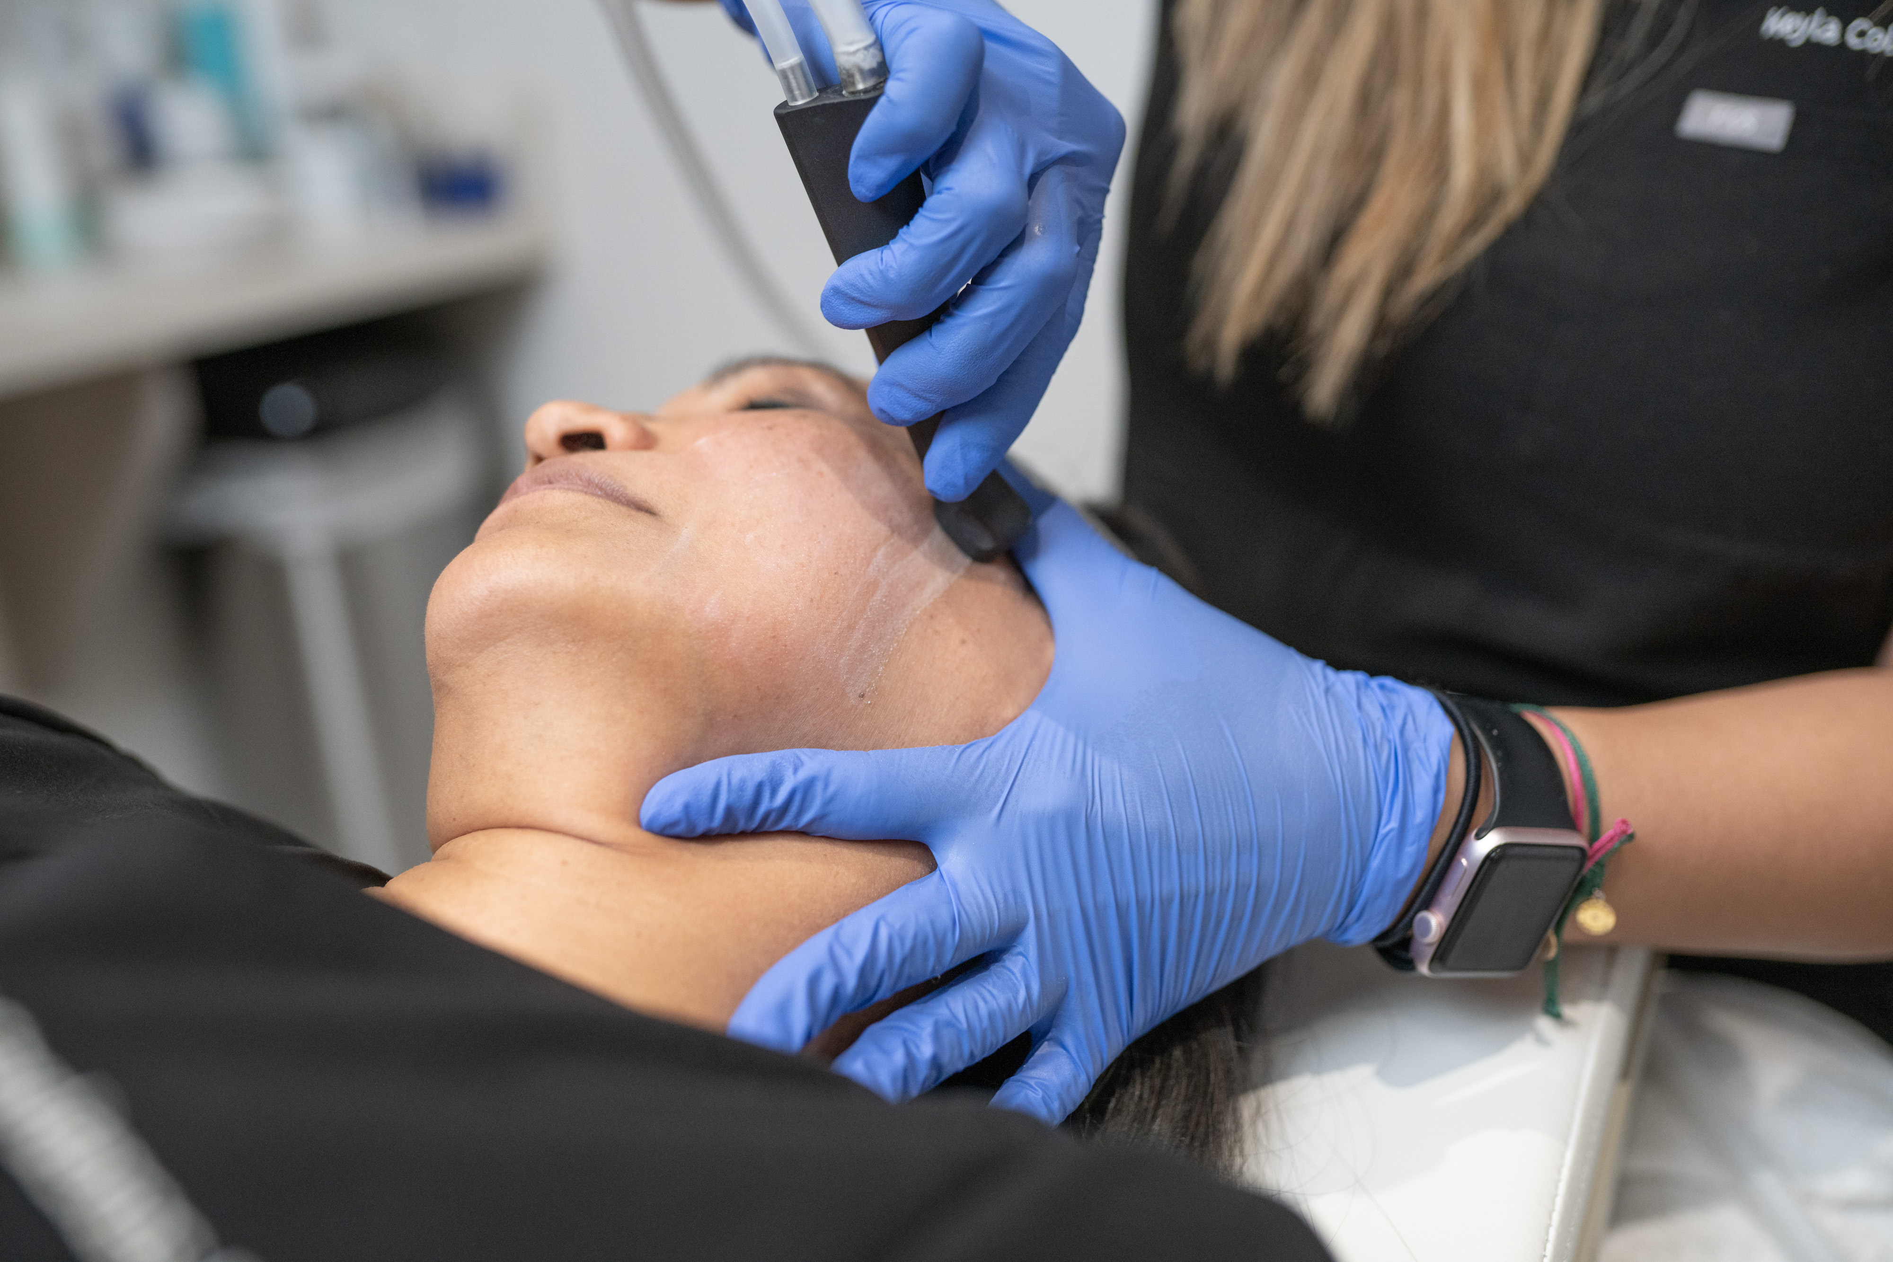
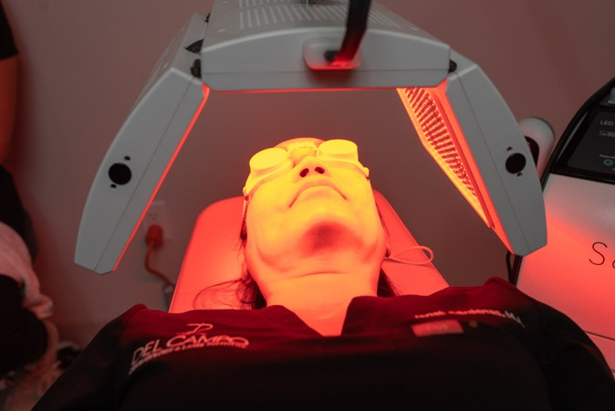
The Science Your Skin Needs.
No Downtime Required!
Visible results in ONE SESSION!
Average treatment time = 45 Minutes.
Courtesy of Del Campo Dermatology

Slide 4

The SaltFacial is not a treatment, it’s a lifestyle.
  The Skin is the largest organ in the body and changes throughout life.
  How old would you be if you didn’t know your age? The SaltFacial is with you every step of the way.

Slide 5
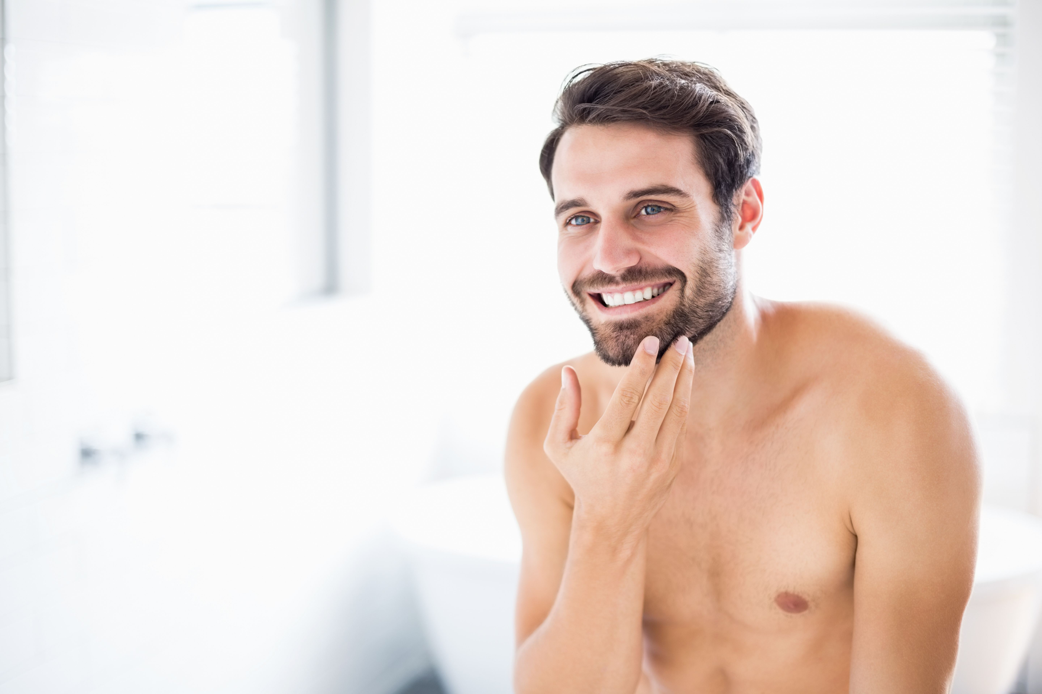
Beauty is more than skin deep.
Only 30% of skincare is what you put on the outside.
The SaltFacial not only maximizes the penetration of skincare products, but also treats multiple layers of the skin for a healthy glow.

Slide 6

Glowing Skin...Without the Filter!
Improve dermal health and address the hallmarks of beautiful skin: TEXTURE, TONE, and COLOR.

Slide 7
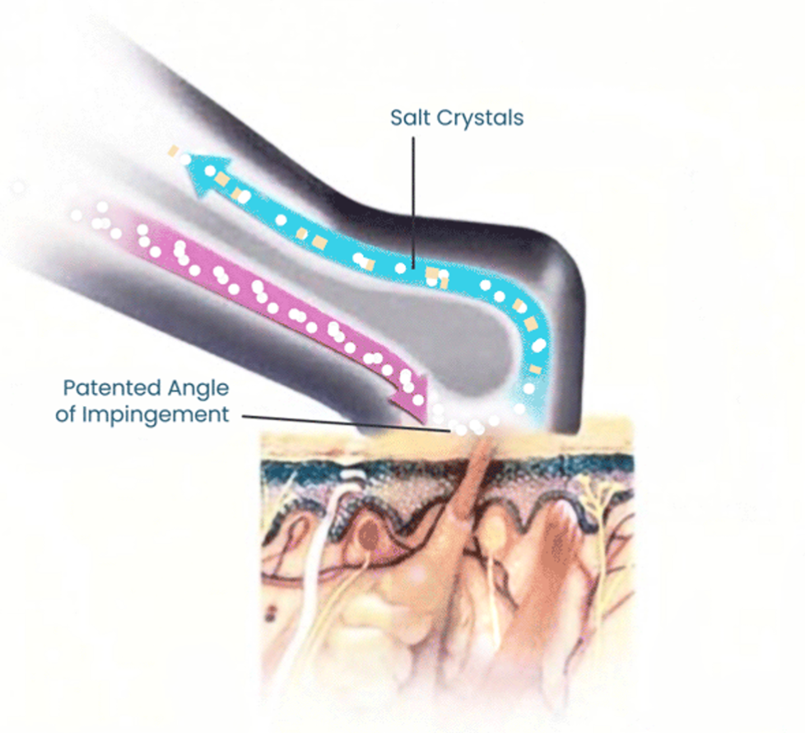
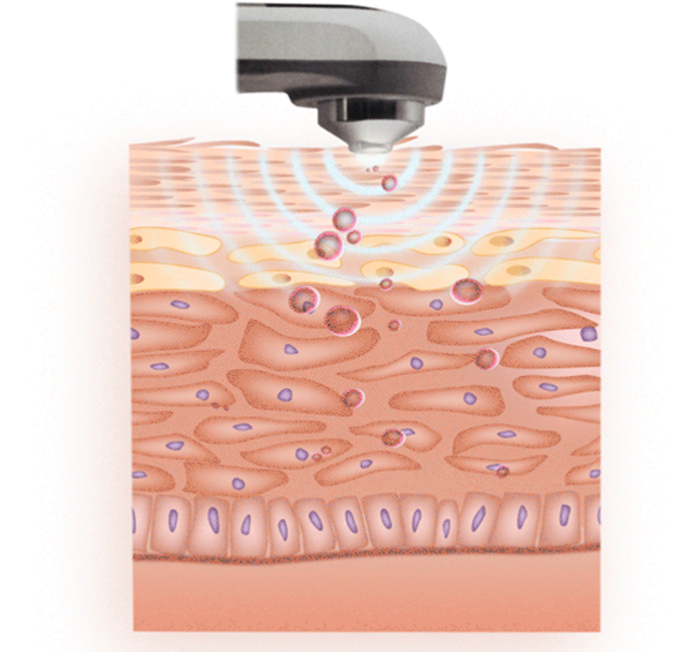
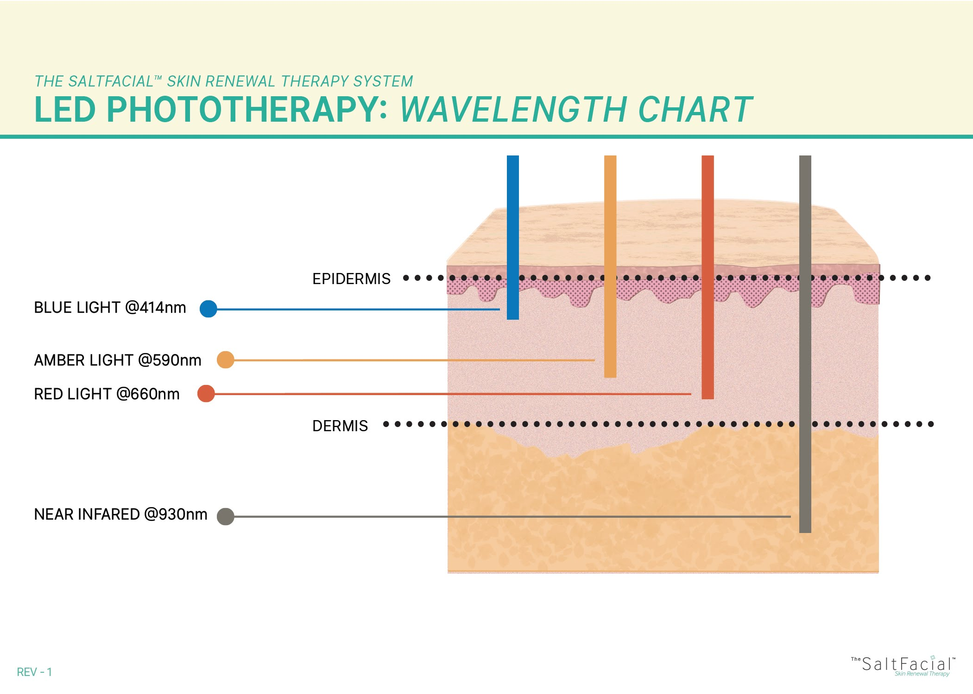
The SaltFacial 3 Step Treatment
STEP 1:
STEP 2:
STEP 3:
Sea Salt Skin Resurfacing
Aesthetic Ultrasound
LED Phototherapy
RESTORE
Reveal your Glow. Fine crystals of pure, natural sea salt are projected through a unique handpiece that’s swept across the skin. Sea salt is both a natural healing element and will hold moisture in at a cellular level, making it an ideal treatment for all skin types. This painless first step removes the dead skin layer that dulls the complexion and challenges even the best skin care products to absorb effectively.
REPLENISH
Nourish and Replenish. Circulation and oxygenation are key to healthy, beautiful skin. This relaxing second step increases microcirculation, which helps topically applied products absorb down deep where they can be most effective.
REJUVENATE
Rest and Rejuvenate. The SaltFacial® Phototherapy uses powerful LED light energy to super-charge cell turnover, helping skin heal and become more beautiful, naturally. This third and final step is completely pain-free and so relaxing that many patients fall asleep during this part of the treatment.

Slide 8
Topicals/Products To Know
SEA SALT
Perfect Concept
THE SALTFACIAL GLIDING GEL
Salt is a humectant that draws and locks in moisture at a cellular level
Naturally antibacterial & antimicrobial
Anti-inflammatory
Non-toxic, natural exfoliation
Contains plant stem cells
Elegant alternative to ultrasound gel
Safe for use on all skin types
Stimulates cell turnover
Detoxifies
Limits excess sebum (oil)
Thickens and strengthens the top layer of skin
* Products not studied in combination

Slide 9

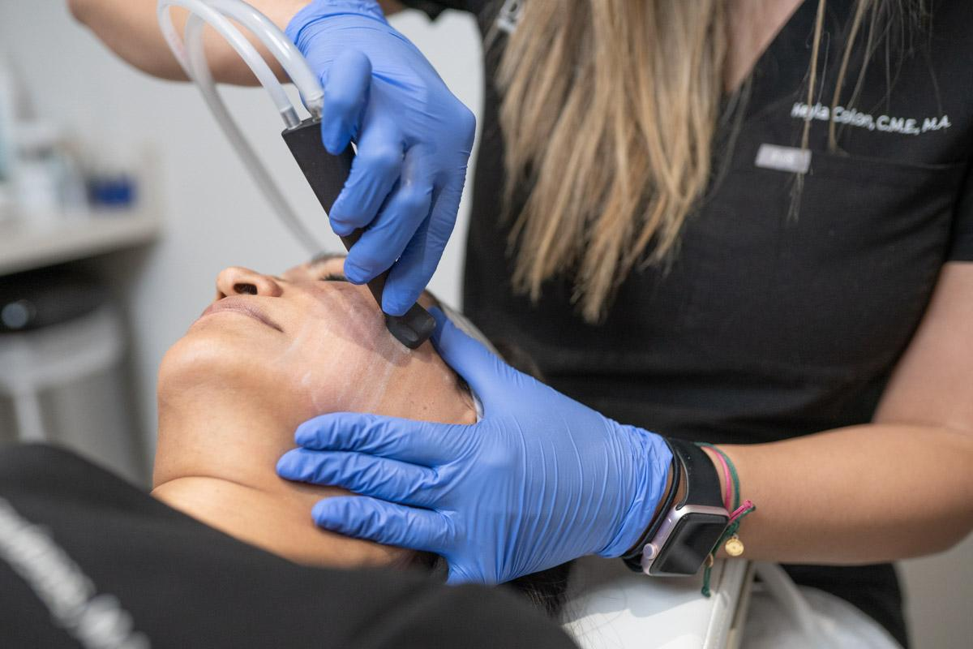
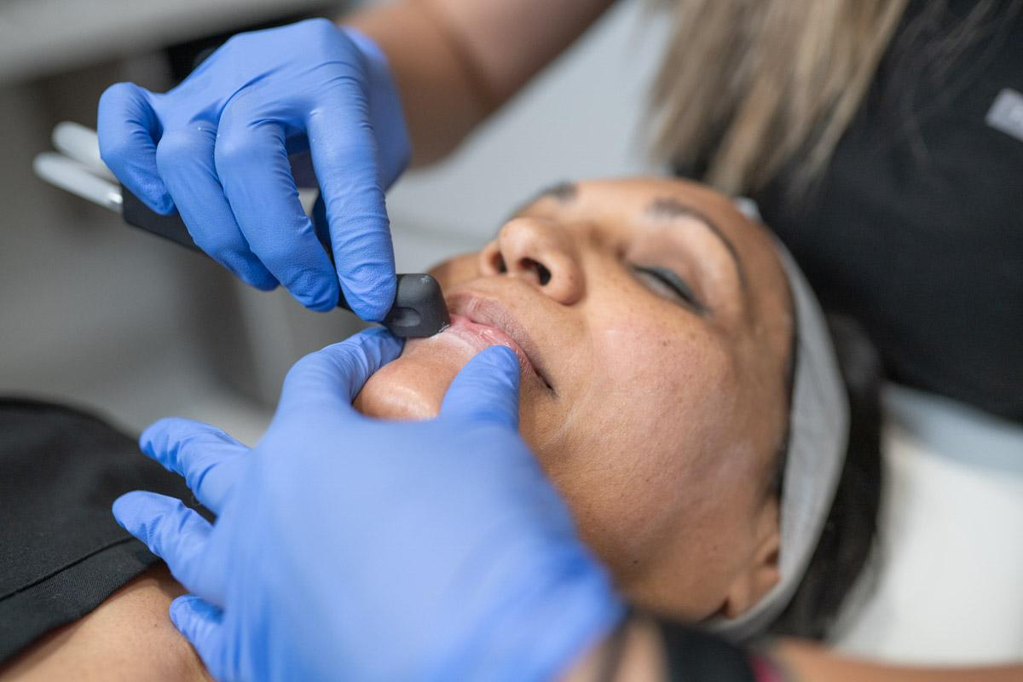

Benefits
Antibacterial & antimicrobial - naturally cleans and sanitizes
Exfoliates
Increases permeability of skin for greater absorption of topical products
Natural humectant - hydrates and draws moisture in at a cellular level
Courtesy of Del Campo Dermatology

Slide 10
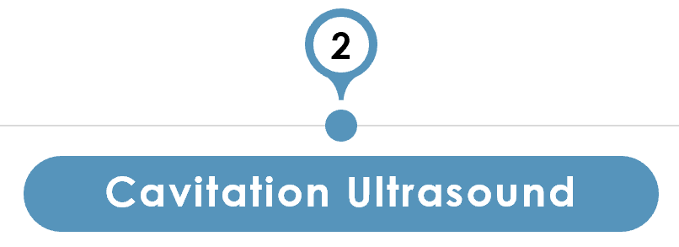
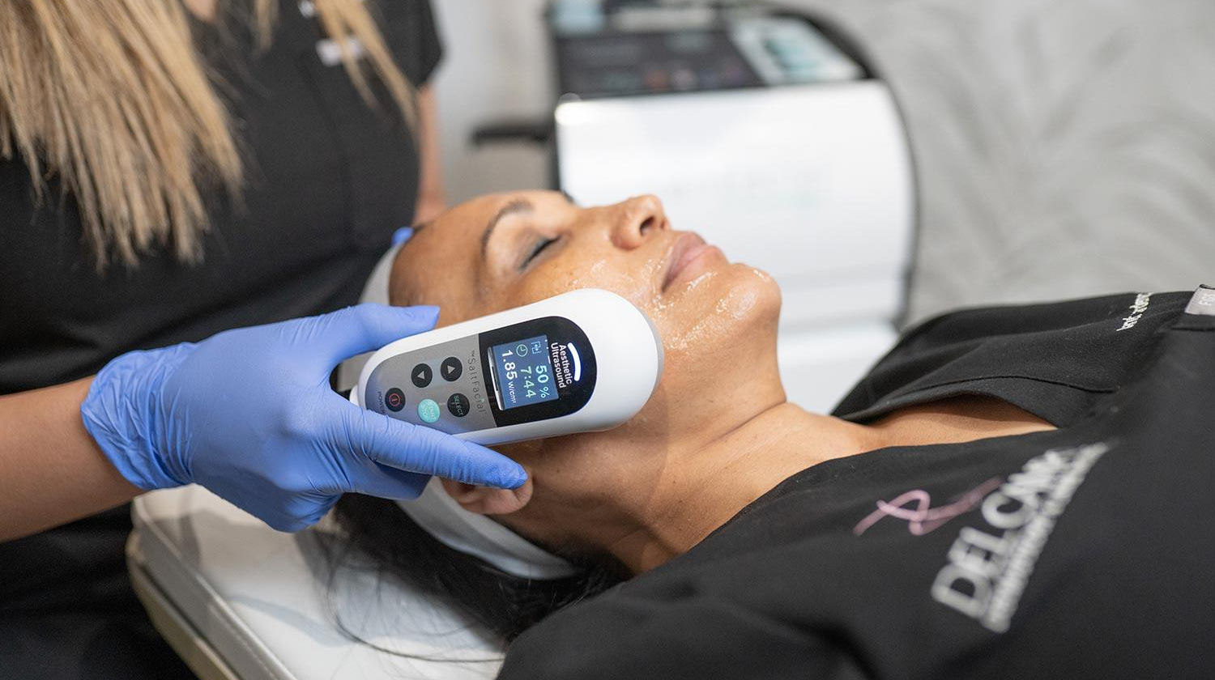
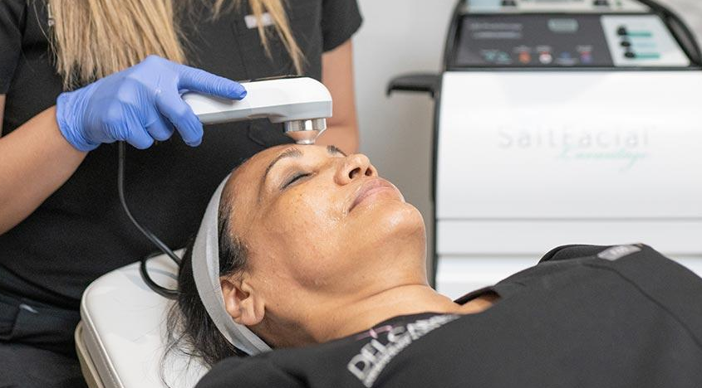
Benefits
Increases tissue permeability - for greater delivery and absorption of topicals
Highly efficient delivery system
Non-thermal - safe for use with wide variety of products and skin types
Courtesy of Del Campo Dermatology

Slide 11
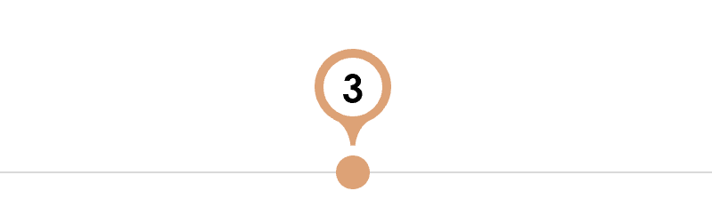
LED PHOTOTHERAPY
Benefits
Promotes accelerated healing
Increases collagen production
Improves microcirculation
Stimulates regenerative process
Kills acne-causing bacteria
Courtesy of Del Campo Dermatology

Slide 12


A Glow…From Head to Toe!
The SaltFacial Addresses Conditions Like:
Uneven skin tone
Fine lines & wrinkles
Age spots
Collagen reformation
Acne
Acne scars
Skin lightening
Pigment variation

Slide 13
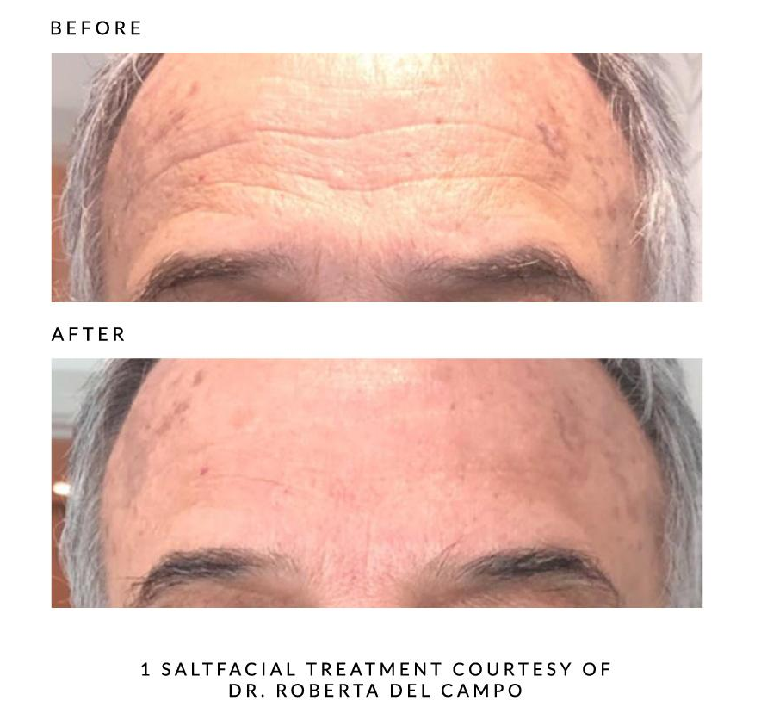
The SaltFacial Results – Anti-Aging

Slide 14
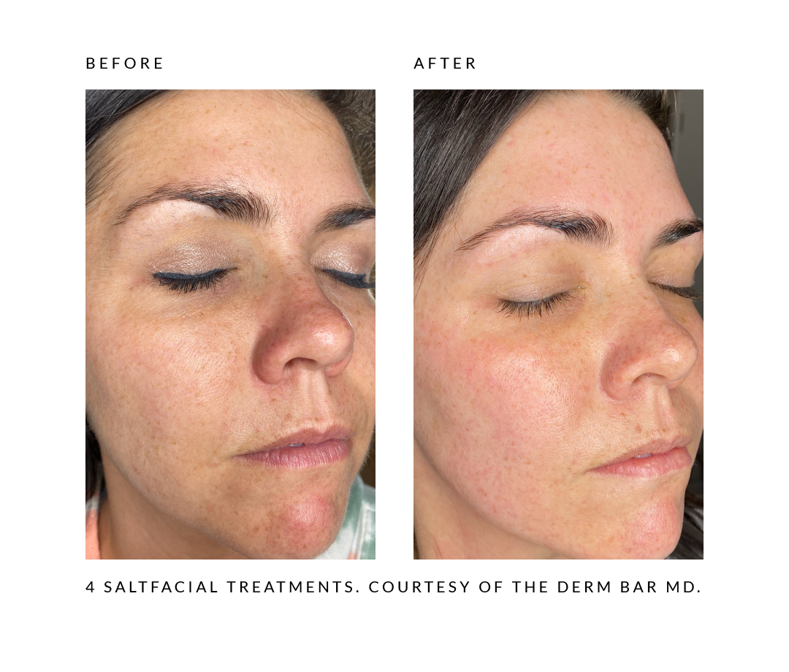
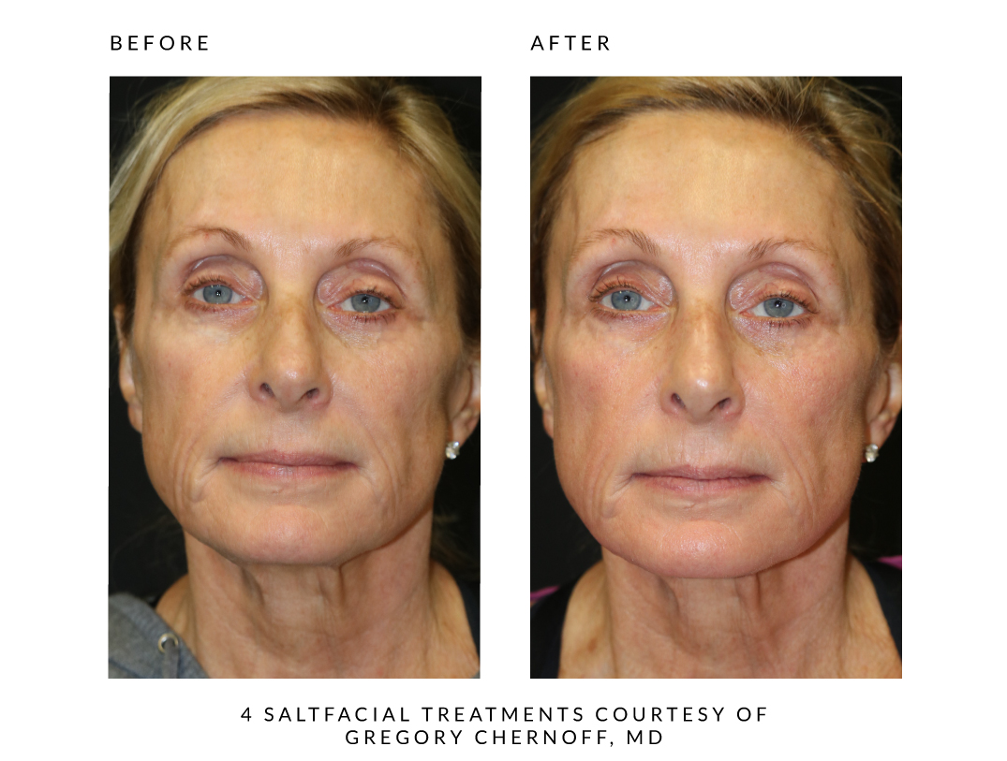
The SaltFacial Results – Texture, Tone, and Color

Slide 15
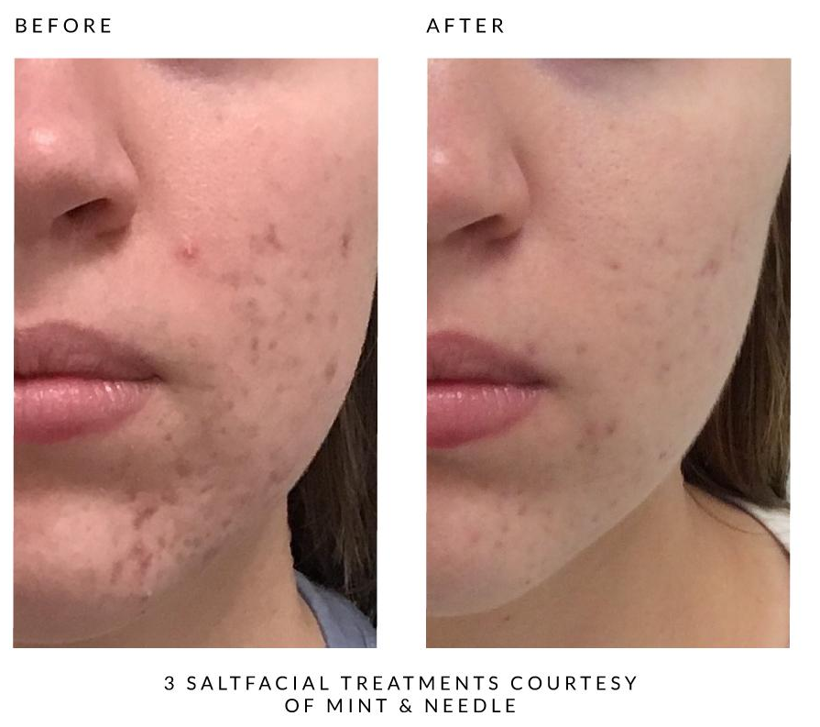
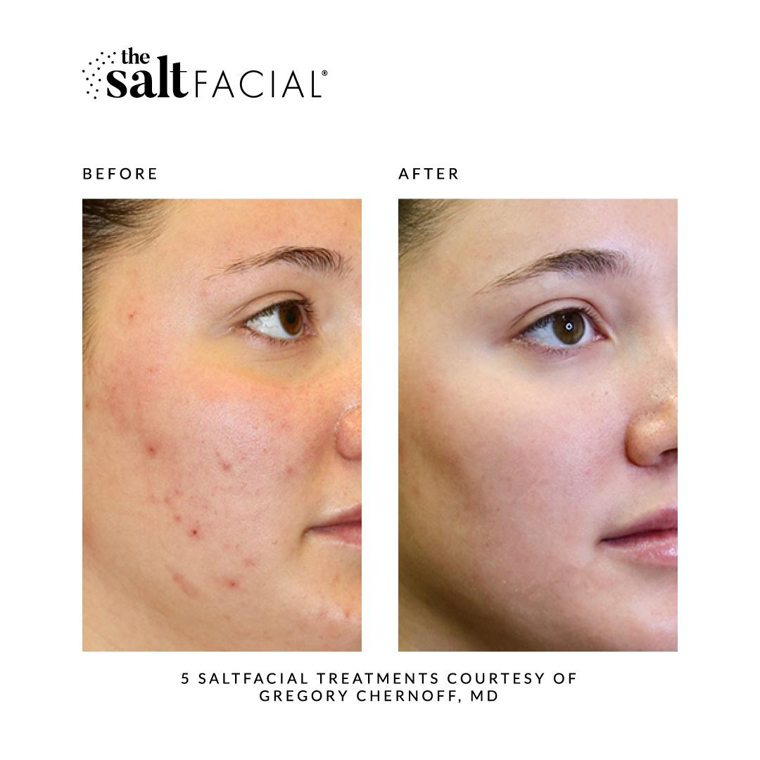
The SaltFacial Results: Acne
FDA-Cleared for Treatment of Acne

Slide 16
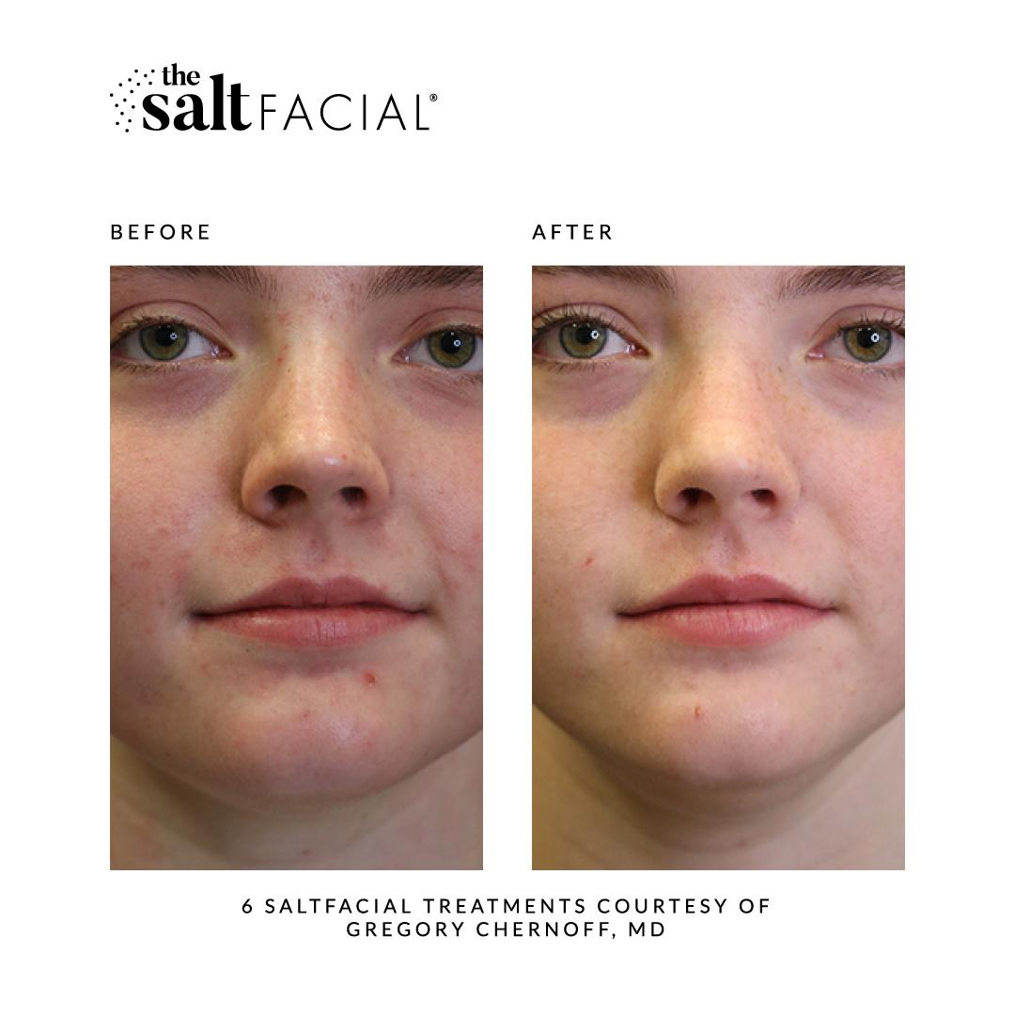
The SaltFacial Results: Acne
FDA-Cleared for Treatment of Acne

Slide 17
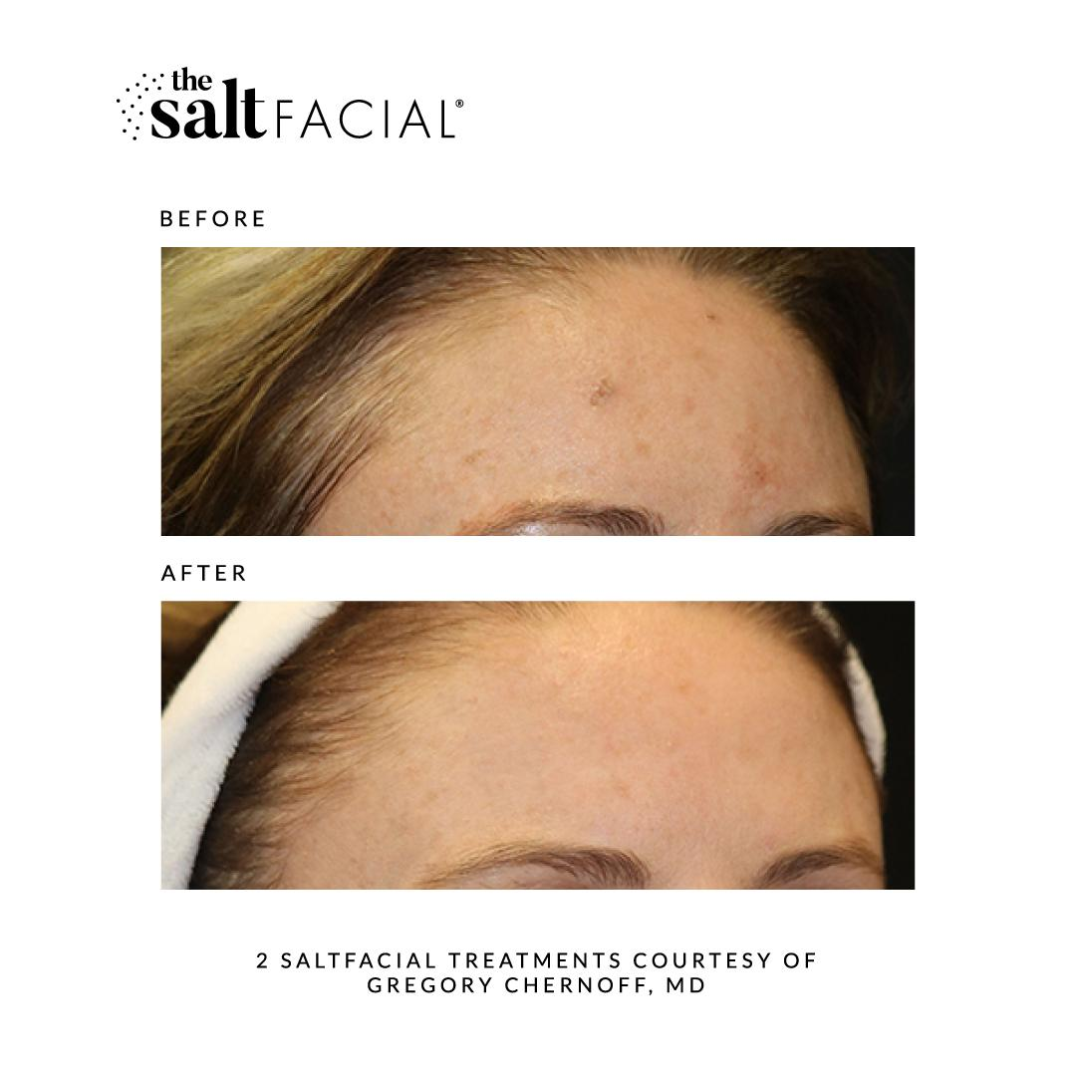
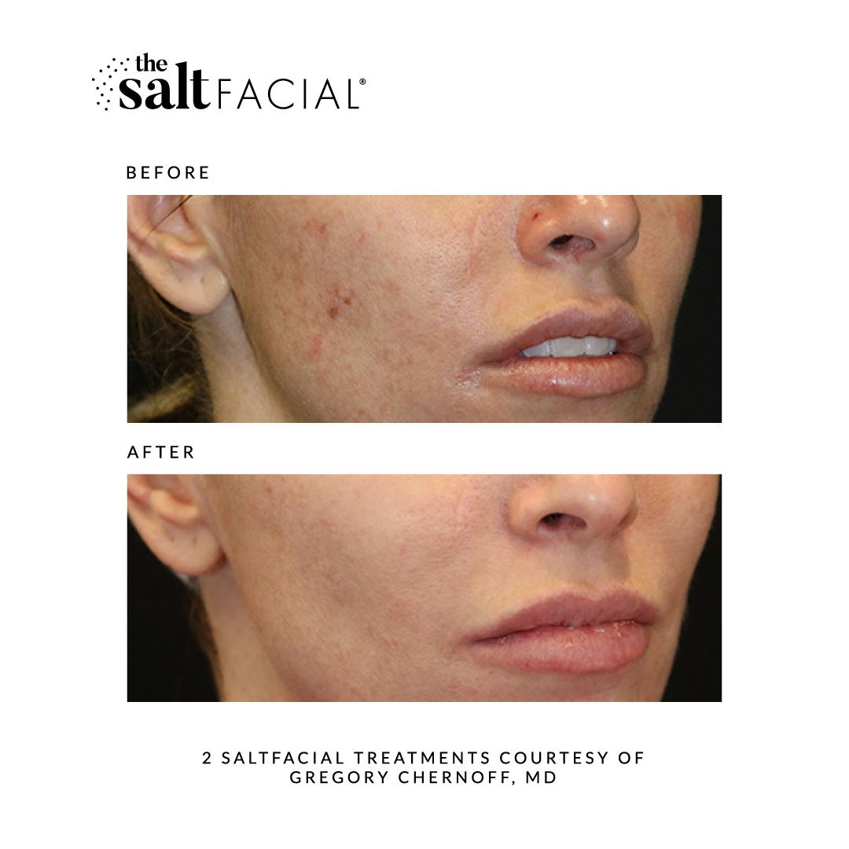
The SaltFacial Results: Pigmentation/Acne

Slide 18
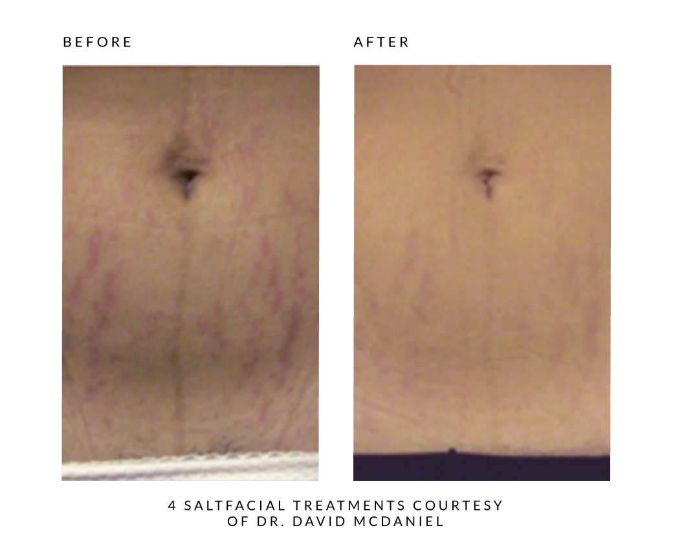
The SaltFacial Results – Body
Stretch Marks- Medium to Severe Class II to III
24 year old patient
Protocol:
The SaltFacial
Product- DermMasque
4 Treatments
14 Day Interval

Slide 19
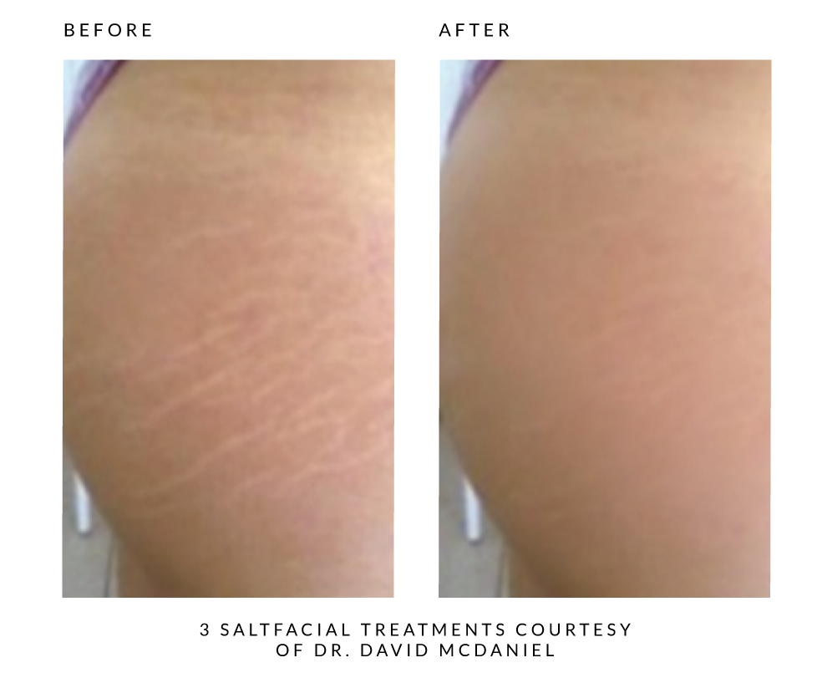
The SaltFacial Results – Body
Stretch Marks- Mild Class I / 24 yr. old patient
Protocol:
The SaltFacial
Product- DermMasque
3 Treatments
7 Day Interval

Slide 20
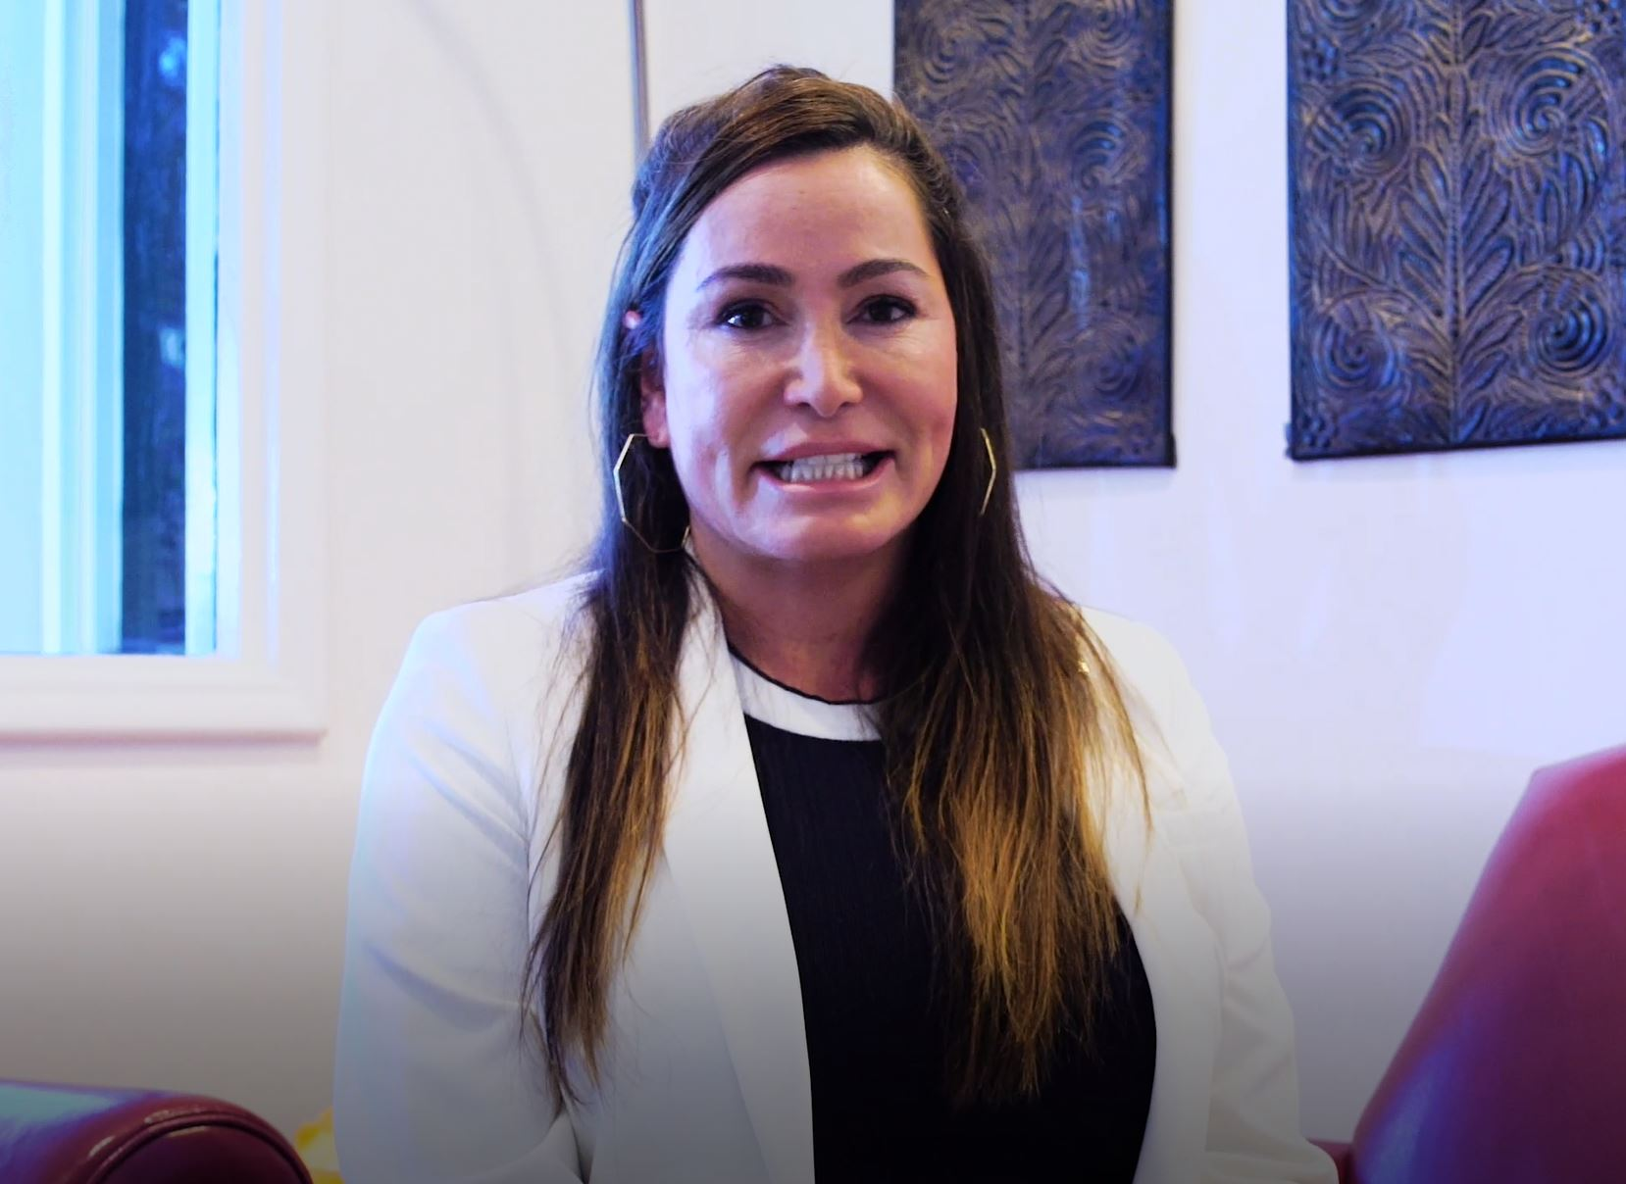

PATIENT TESTIMONIALS
“I noticed the results immediately and continuously over the next few weeks after my treatment. The SaltFacial helped diminish my hyperpigmentation but didn’t prevent me from going outdoors” -Tina Assi, Patient
“I needed something to make my skin glow and it's definitely The SaltFacial. It's amazing because it's all natural, it exfoliates, and makes your skin feel so hydrated, making your skin look so pretty! I just love it. It's the natural way to go and it really works!
Kneeta Harmon, Patient

Slide 21
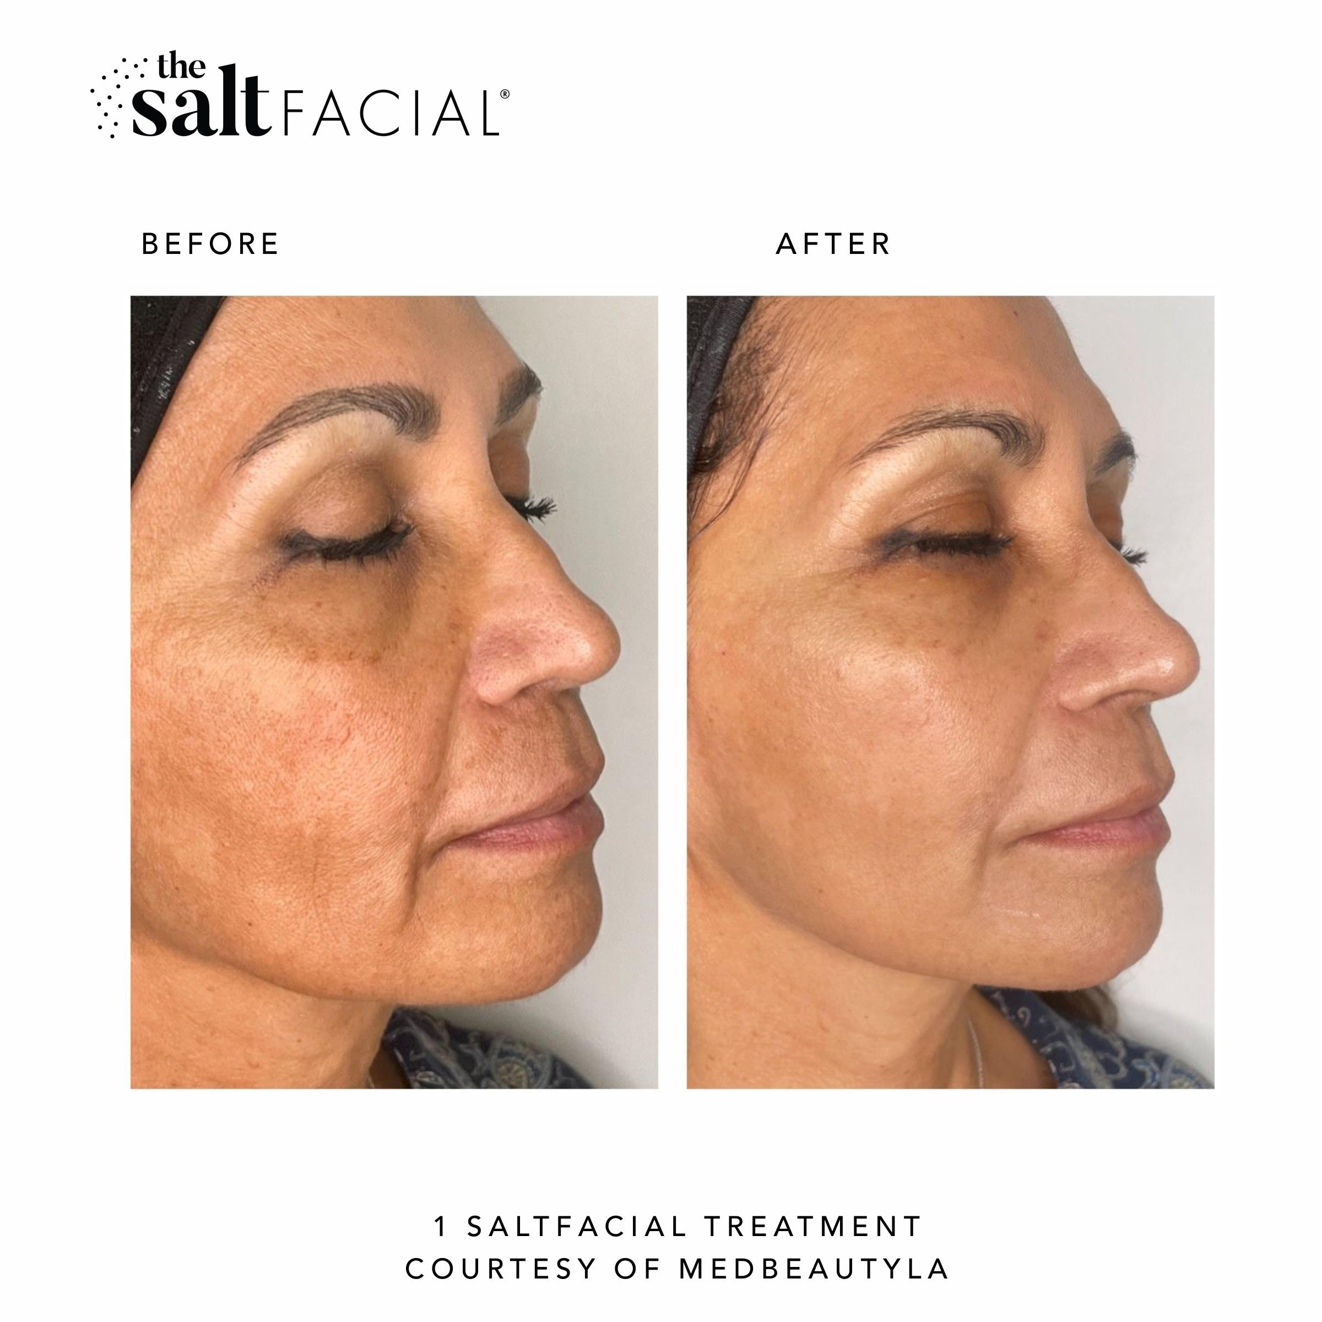
PATIENT TESTIMONIALS
“The SaltFacial is amazing. It creates the best foundation for whatever skincare regimen that we do. It helps me deal with my pigment issues and really keeps my melasma at bay.”
Donna Wilson, Patient

Slide 22












IN THE NEWS
Ashley Iaconetti
(The Bachelor) @Ashley_Iaconetti
“Clear Skin and Glowy AF”
Mario Dedivanovic @MakeupByMario “I am totally glowing right now and fell asleep during the facial”

Slide 23
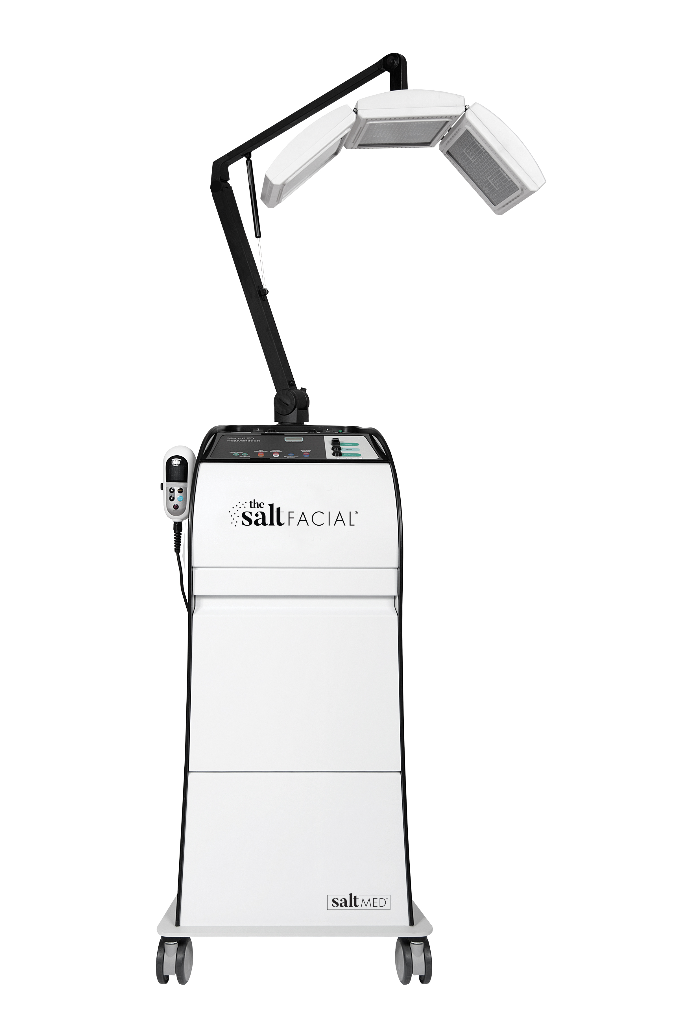




The SaltFacial: The Science Your Skin Needs
The World´s First, True Medical Facial Device.
For a Lifetime of Beautiful Skin...From Head to Toe.
365
Full Body
All Skin Types
No Downtime
High Patient Safety Rating
All Year Around

